Slide 1

NFT Vision Hack
The Misfits

Slide 2

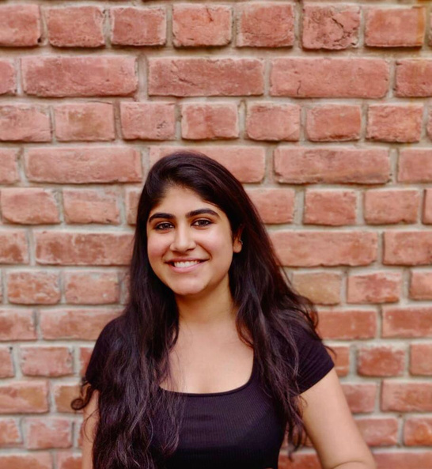
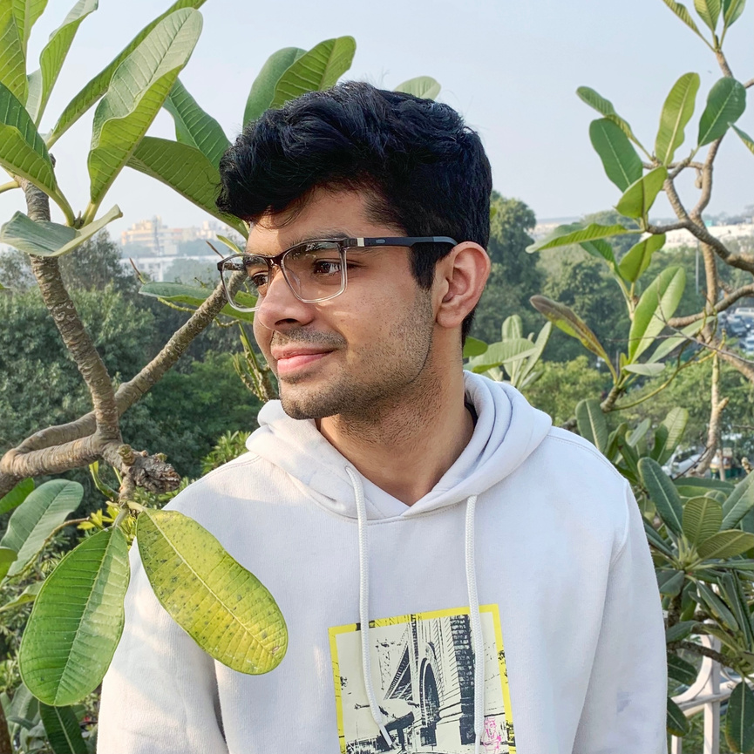
Introduction
…and we are the crazy ones, the misfits, the rebels, the troublemakers. The round pegs in the square holes.

Slide 3
Track of choice
A scalable NFT art project by Indorse

Slide 4
Project
[Please tell us what you have built and how it meets the requirements of the track(s) you chose. Also tell us how you have incorporated the relevant technologies / APIs.]

Slide 5
Technology & Tech Stack
[This is more about the technical aspect of your project. Please tell us more about the technologies you have used to develop your project.]

Slide 6
Scalability
[How can your solution reach vast user adoption. What is your secret sauce?]

